Slide 1
Logo PaaS
Logo Cloud Application Development Platform
Emrecan Şenöz – 17.05.2019

Slide 2
’
’
Application platform as a service (aPaaS) is a PaaS offering that supports application development, deployment and execution in the cloud.
’
’
Gartner, 2018

Slide 3
Objectives
Shorten Time to Market
Ensure Security and Governance
Reduce App Maintenance Costs
Highly Availability and Scalability

Slide 4



Single Integrated Platform
01
User Interface
DBMS
02
03
Business Logic
Security
04
05
Integration
Mobile
06
07
Reporting
Collaboration
08

Slide 5
aPaas Capabilities
Integration
API Creation
API Authorization
Service Discovery
Orchestration or choreography of pages and business processes
Data, process and
logic
Built-in Database
Dashboard
Report Designer
Documents
Business Process Management
Mobile and Multichannel
Enterprise
Mobile Services
Responsive UI
Multichannel Apps
IoT Support
PaaS
High Availability
Disaster Recovery
Multi-Cloud Support
Diagnostic Tools
SLA
Internationalization
Tenant Isolation
Secure Access
Service Pricing
Identity Management
Authorization Management

Slide 6
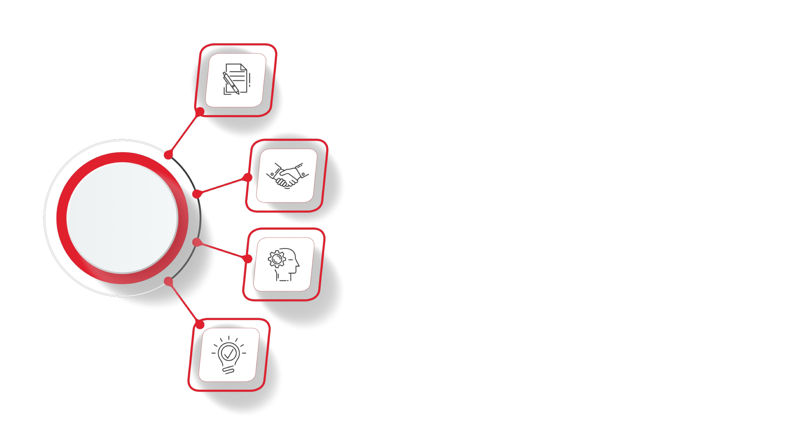
Leverage your Apps with Logo Expertise
ERP
Human Resources
Enterprise
e-Government
CRM

Slide 7





Microservice Architecture
Advantages
Improve Fault Isolation
Version upgrade without any downtime
High Availability and Scalability
Independent development teams
Simple to understand each service
Disadvantages
System complexity over monolithic applications
Increasing number of remote calls between microservices
https://microservices.io/patterns/microservices.html

Slide 8
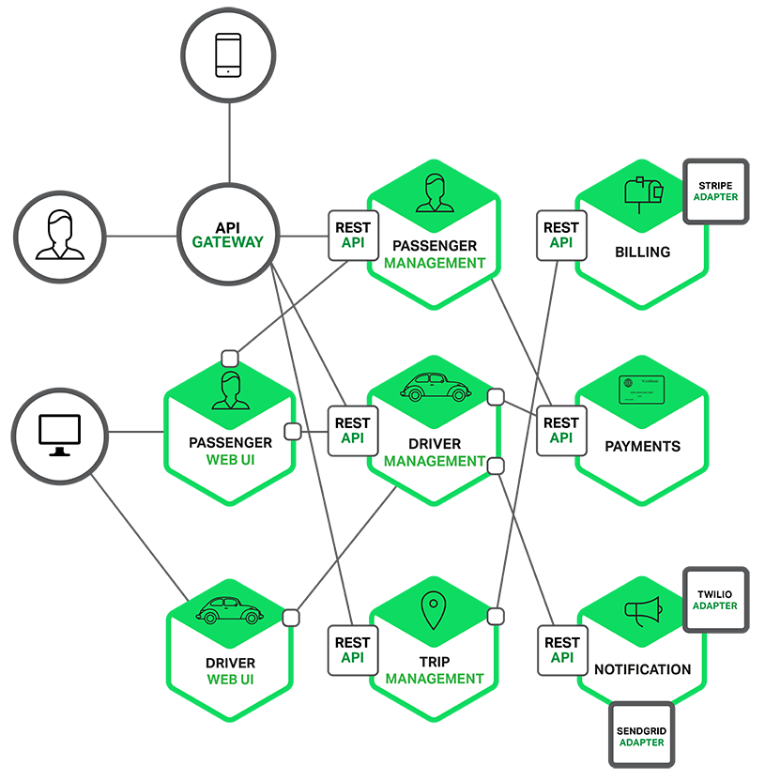
Microservice Architecture: Uber Example
2 different web apps : Passenger and Driver
Each back-end service exposes a REST API and most services consume APIs provided by other services. Driver Management uses the Notification server to tell an available driver about a potential trip. The UI services invoke the other services in order to render web pages. Services might also use asynchronous, message-based communication. Inter-service communication will be covered in more detail later in this series.
External Communication – API - is mediated by an intermediary known load balancing, caching, access control, API metering, and monitoring as an API Gateway (load balancing, caching, access control, API metering, and monitoring)
https://dzone.com/articles/microservice-architecture-learn-build-and-deploy-a

Slide 9
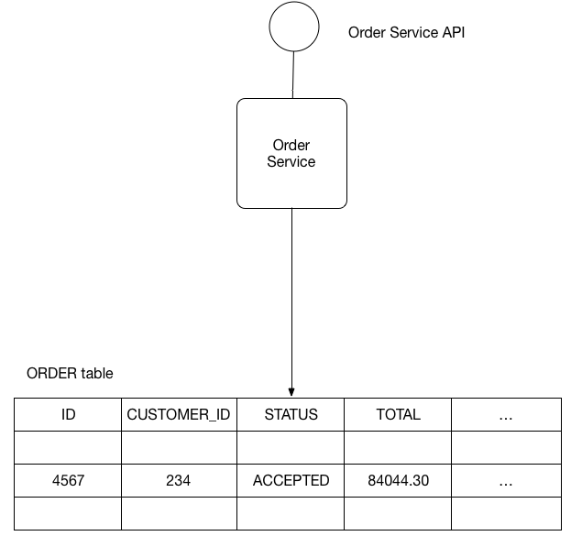
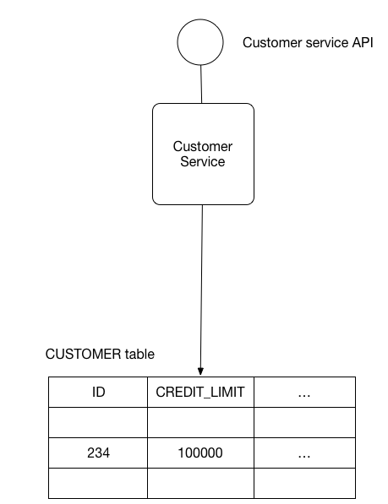
Database per service pattern
Keep each microservice’s persistent data private to that service and accessible only via its API. A service’s transactions only involve its database.
Some business transactions, however, span multiple service so you need a mechanism to ensure data consistency across services.
Transactions in different databases the application cannot simply use a local ACID transaction.
https://microservices.io/patterns/data/database-per-service.html

Slide 10
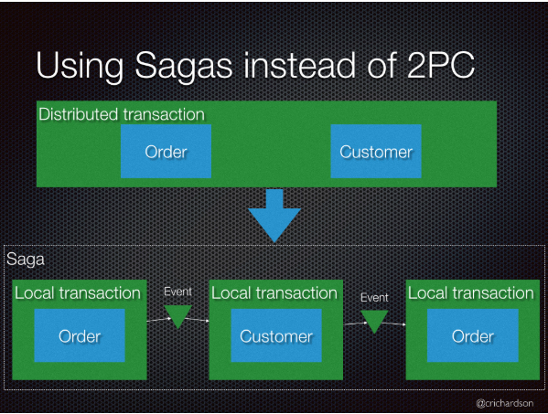
Saga Pattern
Implement each business transaction that spans multiple services as a saga. A saga is a sequence of local transactions.
Each local transaction updates the database and publishes a message or event to trigger the next local transaction in the saga.
If a local transaction fails because it violates a business rule then the saga executes a series of compensating transactions that undo the changes that were made by the preceding local transactions.
https://microservices.io/patterns/data/saga.html

Slide 11
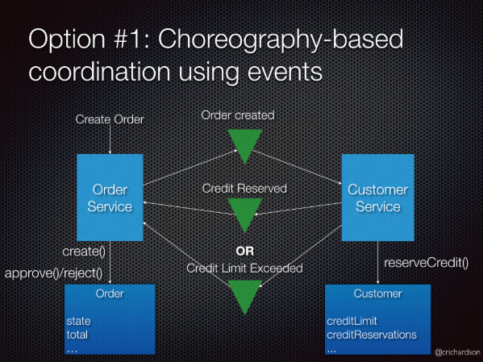
Choreography-based saga
Each local transaction publishes domain events that trigger local transactions in other services
An e-commerce application that uses this approach would create an order using a choreography-based saga that consists of the following steps:
The Order Service creates an Order in a pending state and publishes an OrderCreated event
The Customer Service receives the event attempts to reserve credit for that Order. It publishes either a CreditReserved event or a CreditLimitExceeded event.
The Order Service receives the event and changes the state of the order to either approved or cancelled
https://microservices.io/patterns/data/saga.html

Slide 12
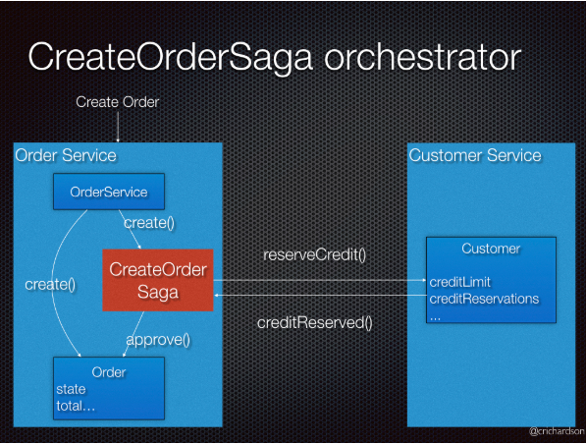
Orchestration-based saga
An orchestrator (object) tells the participants what local transactions to execute
An e-commerce application that uses this approach would create an order using an orchestration-based saga that consists of the following steps:
The Order Service creates an Order in a pending state and creates a CreateOrderSaga
The CreateOrderSaga sends a ReserveCredit command to the Customer Service
The Customer Service attempts to reserve credit for that Order and sends back a reply
The CreateOrderSaga receives the reply and sends either an ApproveOrder or RejectOrder command to the Order Service
The Order Service changes the state of the order to either approved or cancelled
https://microservices.io/patterns/data/saga.html

Slide 13


The Logo way
Sagas are handled by Activiti workflows and Kafka topics
Activiti is a light-weight workflow and Business Process Management (BPM) Platform targeted at business people, developers and system admins. Its core is a super-fast and rock-solid BPMN 2 process engine for Java.
Apache Kafka® is a distributed streaming platform. Kafka, publishes and subscribes to streams of records, similar to a message queue or enterprise messaging system. Kafka stores streams of records in a fault-tolerant durable way and provides retries, circuit-breaking, rate-limiting, monitoring etc features.
https://www.activiti.org/
https://kafka.apache.org/intro

Slide 14
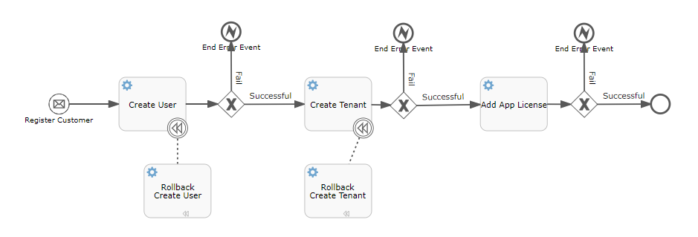
The Logo way
User-facing services provide REST API’s to the UI. State changes are journaled to Kafka as events.
RegisterCustomer event is thrown.
Choreography is handled between microservices using workflows. Activiti triggers microservices with Rest calls
If transactions fails, workflow completed with error event and rollbacked via compensation tasks.
In Activiti compensation is performed in reverse order of execution. This means that whichever activity completed last is compensated first, etc.

Slide 15

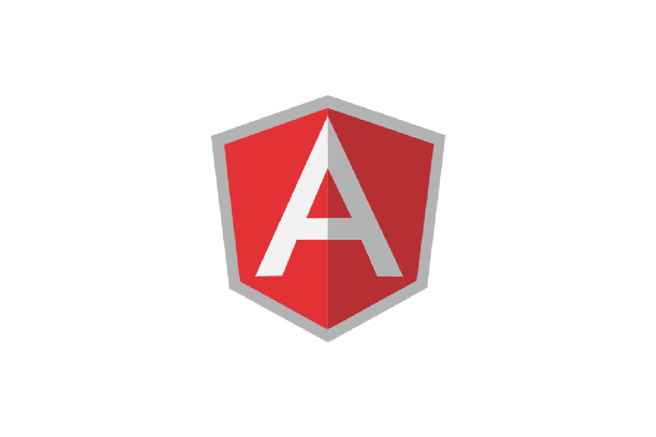
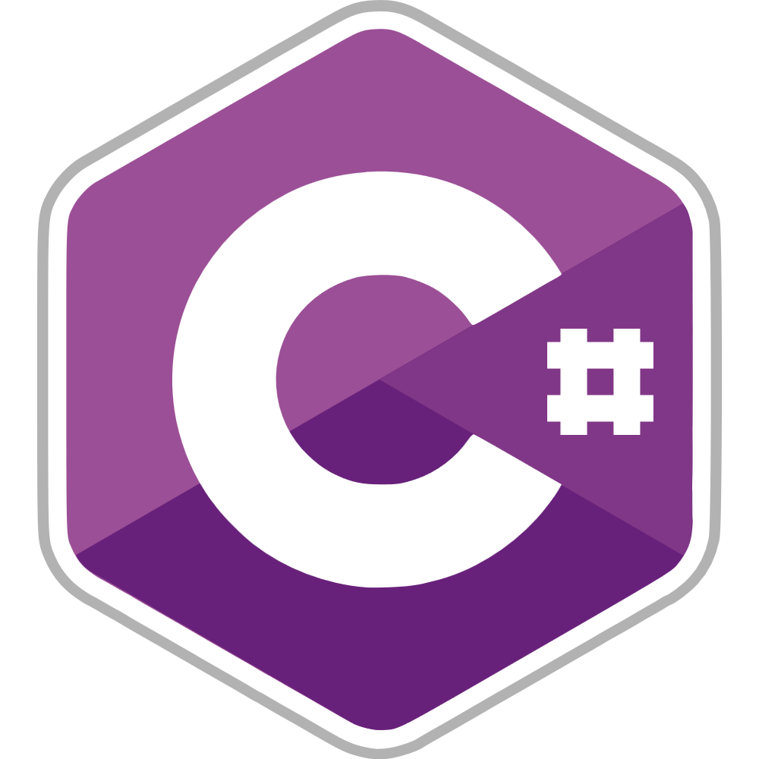








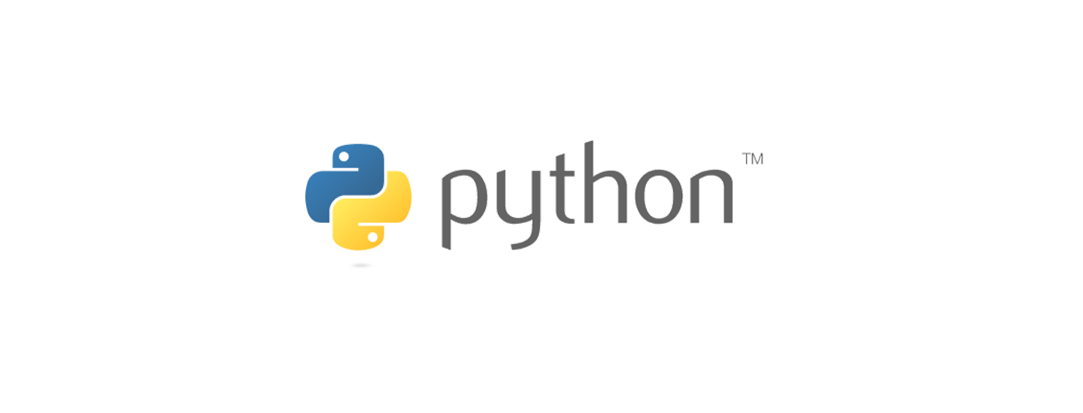
Technology Stack
Broad range of Languages, Frameworks and Technologies

Slide 16







Member of Opensource Community
Extensive use and support to opensource technologies

Slide 17







Infrastructure Agnostic Deployments
Logo aPaas has being served on:
3
IaaS
AWS Ireland
AWS Mumbai
2
Continents

Slide 18





Highlights
+10K
Customer
3
2
IaaS
Continents
+50
28
7
2
Libraries
Microservices
SaaS App
ERP

Slide 19
Thanks

